Slide 1


Networking and
Services
Brought to you by

Slide 2
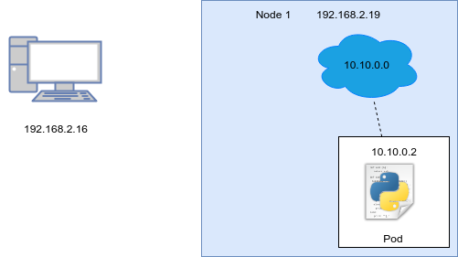
Basic Network Overview

Slide 3
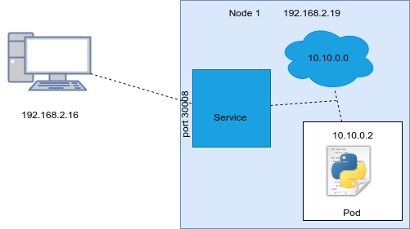
Service

Slide 4
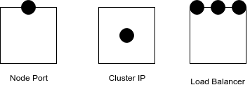
Types of Services

Slide 5
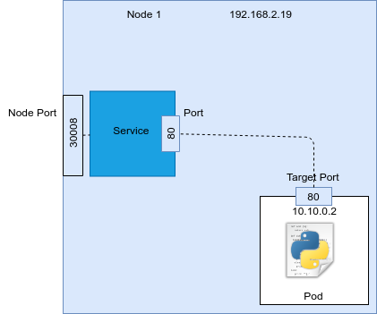
Parts of a Service

